Slide 1
Full Interoperability between Security and Comfort Applications
BIM VIRTUAL WORLD 2020 – 24 & 25 Nov 2020
Notes:
1
Schriftarten komplett ersetzt: Frutiger durch Arial (16.05.2006)

Slide 2
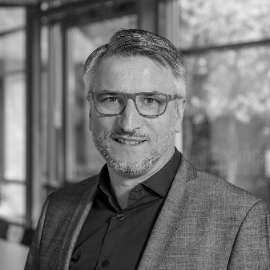
Managing Director
since 2001 managing director of siganet GmbH
Member of the guidelines committee VDI 3814 (building automation)
Speaker at the VDI for training as a certified specialist engineer for GA
Speaker for GA training at BBR in Bonn and Berlin
Collaboration on the BImA-LF for building automation
Holger Wallmeier
Dipl.-Ing. (FH) Elektrotechnik

Slide 3
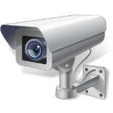
Security
Building automation
Networks
BMS

Slide 5
Management- and User Interface
Interoperability and integration ?
Notes:
5
Schriftarten komplett ersetzt: Frutiger durch Arial (16.05.2006)

Slide 6
Management- and User Interface
Management-
Level
Subsystems
Devices

Slide 7
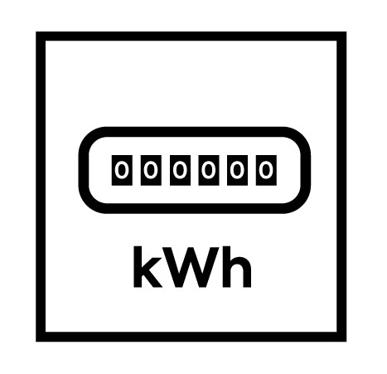
Management- User Interface
GMS
BMS 3
Management-
Level
Subsystems /
AutomationLevel
Devices / Field Level

Slide 8
Management- User Interface
BMS 2
GLT
Management-
Level
Subsystems /
AutomationLevel
Devices / Field Level
Abb.: siganet

Slide 9
Management- User Interface
BMS 2
BMS 3
Management-
Level
Subsystems /
Automation Level
Devices / Field Level

Slide 10
BMS 1
Management- User Interface
BMS 2
BMS 3
Management-
Level
Subsystems /
AutomationLevel
Devices / Field Level

Slide 11
Management- User Interface
Integration
BMS
Management-
Level
Subsystems /
AutomationLevel
Koexistenz
Devices / Field Level

Slide 12
Next level. Integration on the automation and field level
Notes:
12
Schriftarten komplett ersetzt: Frutiger durch Arial (16.05.2006)

Slide 13
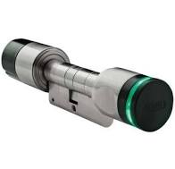
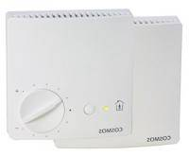
System Architecture
Management- and User Level
VDI 3813
VDI 3814
Room-automation
Application-automation

Slide 14
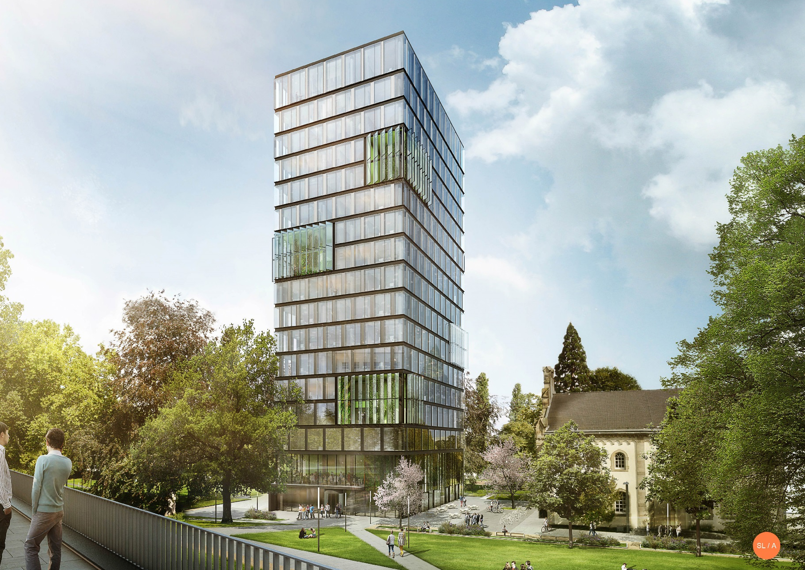
UN Campus Bonn

Slide 15
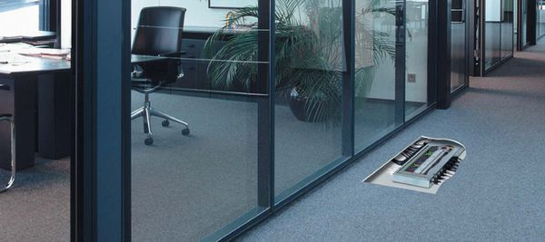
Previously: axially flexible structure with cabling
Abb.: SPEGA, Segment distributor in the cavity floor

Slide 16
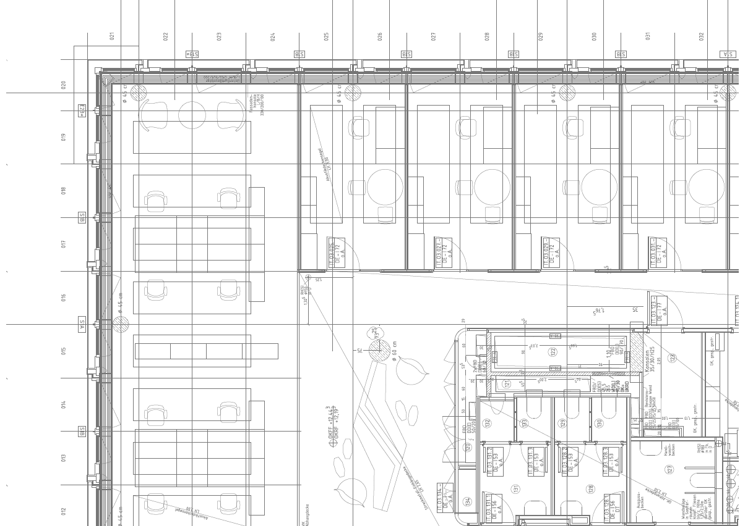
Axis-flexible construction
VDI 3813: Roomautomation (Space)

Slide 17
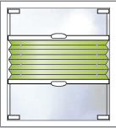
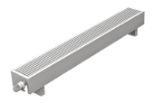
Axis-flexible construction
VDI 3813: Roomautomation (Segmente)
8
7
6
5
4
3
2
1

Slide 18
Axis-flexible construction
VDI 3813: Roomautomation (Räume)
4
3
2
1

Slide 19
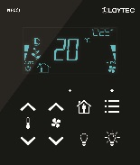
Axis-flexible construction
VDI 3813: Roomautomation (Räume)
4
3
2
1

Slide 20
Axis-flexible construction
VDI 3813: Roomautomation (Räume)
3
2
1

Slide 21
Axis-flexible construction
VDI 3813: Roomautomation (Räume)
2
1

Slide 22
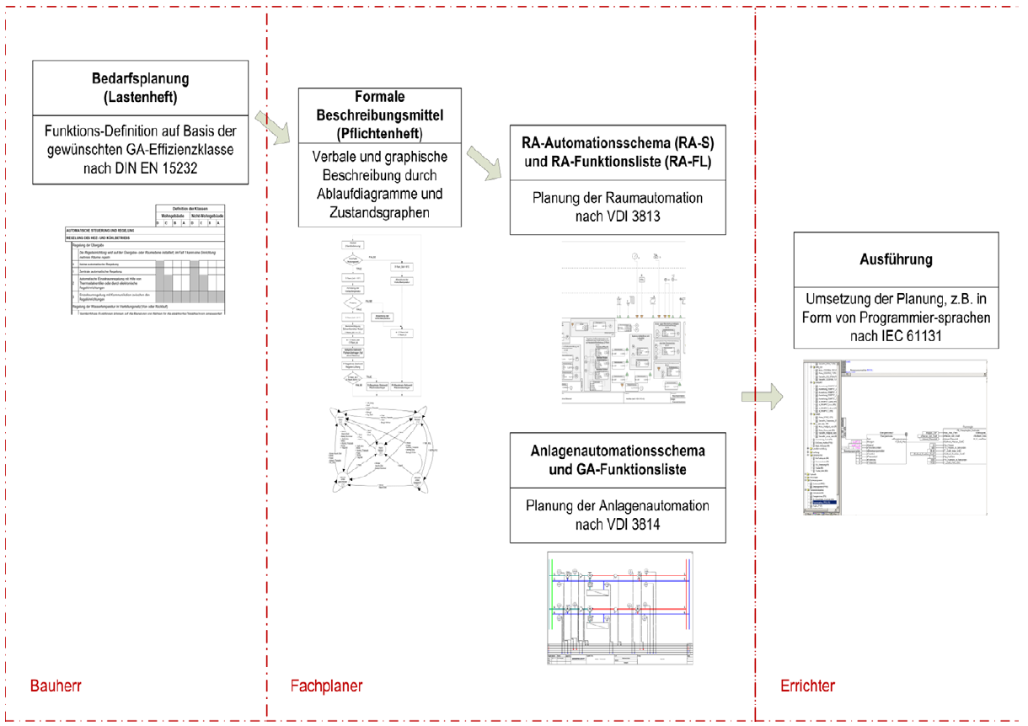
Planning process
LPH 1 LPH 2 – 7 LP 8
Quelle: Weißbuch (White Paper) Nachhaltiges Planen, Bauen und Betreiben durch Einsatz von Gebäudeautomation

Slide 23
Planning process
VDI 3813
VDI 3814
LPH 1 LPH 2 – 7 LP 8
Quelle: Weißbuch (White Paper) Nachhaltiges Planen, Bauen und Betreiben durch Einsatz von Gebäudeautomation

Slide 24
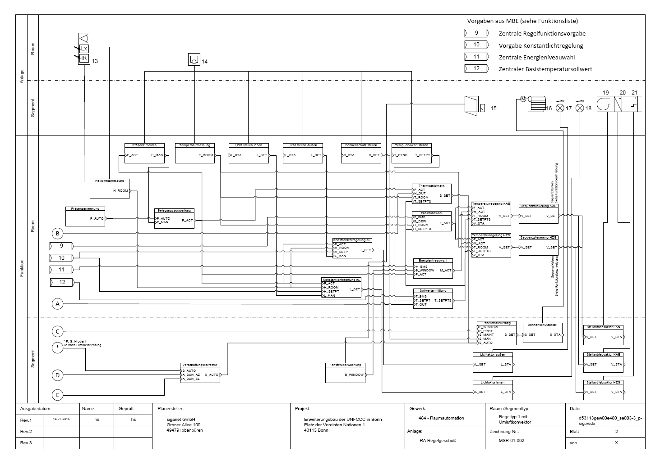
VDI 3813: AS scheme + function list
Multisensor / Erfassung
Leuchte
Auswertung
Regelung

Slide 25
in the future: Axis-flexible construction WITHOUT cabling

Slide 26
IoT – Internet of Things
Notes:
26
Schriftarten komplett ersetzt: Frutiger durch Arial (16.05.2006)

Slide 27
BMS
External serviceprovider /
New business models
Notes:
27
Schriftarten komplett ersetzt: Frutiger durch Arial (16.05.2006)

Slide 28
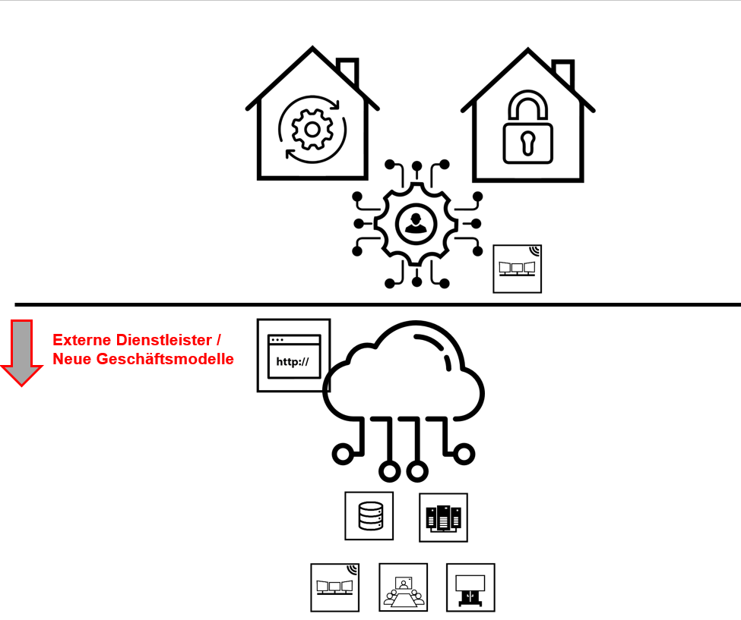
Business models from the cloud
Data analysis for problem solving
Data analysis for maintenance and repair
Data analysis for energy management
AI _ Artificial Intelligence
... .. (new business models)
Notes:
28
Schriftarten komplett ersetzt: Frutiger durch Arial (16.05.2006)

Slide 29
SRI – Smart Readyness Indikator
Notes:
29
Schriftarten komplett ersetzt: Frutiger durch Arial (16.05.2006)

Slide 30
SRI – Smart Readiness Indicator
The EU directive (EU) on the overall energy performance of buildings came into force on July 9, 2018.
EU countries have 20 months to transpose into national law -> until March 2020
by the end of 2019 system for assessing the intelligence capability of buildings
=> SRI - Smart Readiness Indicator
=> Factor for the intelligence of buildings
Grundlagenstudie aus 02/2019

Slide 31
Summary
Notes:
31
Schriftarten komplett ersetzt: Frutiger durch Arial (16.05.2006)

Slide 32
Summary
Smart IP500 solutions will be commonplace and ubiquitous
This applies to the home area and functional buildings
In a digital world we will leave digital traces
Digital protection must not be an obstacle if Germany e.g. wants to be a leader in AI etc.
Intelligence factor SRI as an orientation for investors
SRI expresses the ability to meet the requirements of current and future smart applications.

